Slide 1
Chapter 9: Universal Synchronous Asynchronous
Receiver Transceiver
The PIC18 Microcontroller
Han-Way Huang
Minnesota State University, Mankato
June 2004

Slide 2
Why Serial Communication?
Parallel I/O uses many signal pins.
Synchronization problem over longer distance
Cost of cable
Many applications do not need high data rate
Types of Serial I/O
1. USART (universal synchronous asynchronous receiver and transceiver)
2. SPI (synchronous peripheral interface)
3. I²C (inter-integrated circuit)
4. CAN bus (controller area network bus)
5. LIN (local interconnect network) – won’t be covered

Slide 3
The EIA232 Standard
Developed in 1960 by electronic industry association.
The latest revision is EIA232E.
EIA232 is also referred to as RS232 for historical reason.
Both computers and terminals are called data terminal equipment (DTE).
Modems, bridges, and routers are called data communication equipment (DCE).
There are four aspects to the EIA232:
1. Electrical specifications
2. Functional aspects—the function of each signal
3. Mechanical specifications
4. Procedural specifications

Slide 4
Electrical Specifications
- Data rates: EIA232 is applicable to data rate no more than 20 Kbps. The most commonly used data rates are 300, 1200, 2400, 9600, and 19200 baud
Signal state voltage assignments:
1. voltages between -3 V to -25 V are considered as logic 1
2. voltages between +3 V to 25 V are considered as logic 0
Signal transfer distance: Signal should be able to transferred correctly up to 15 meters.

Slide 5
Functional Specifications
Twenty-two signals are defined.
Signals are divided into six groups:
1. Signal ground and shield
2. Primary communication channel
3. Secondary communication channel
4. Modem status and control signals
5. Transmitter and receiver timing signals
6. Channel test signals
Secondary communication channel consists of the same signals as in the primary channel but rarely used.
Timing signals are not used in asynchronous mode
Channel test signals are not used in normal communications

Slide 6
Primary Communication Channel Signals
Pin 2: transmit data
Pin 3: receive data
Pin 4: request to send signal (RTS)—asserted when in logic 0
Pin 5: clear to send signal (CTS)—asserted when in logic 0
Modem Status and Control Signals
Pin 6: data set ready (DSR)—asserted when in logic 0
Pin 20: DTE ready (DTR)—asserted when in logic 0
Pin 8: received line signal detector (CD)—also called carrier detect, asserted in logic 0
Pin 22: ring indicator (RI)—asserted when in logic 0
Pin 23: data signal rate selector—asserted when in logic 0

Slide 7
Mechanical Specification
Specifies a 25-pin connector
A 9-pin connector is used most often in PC but not specified in the standard

Slide 8
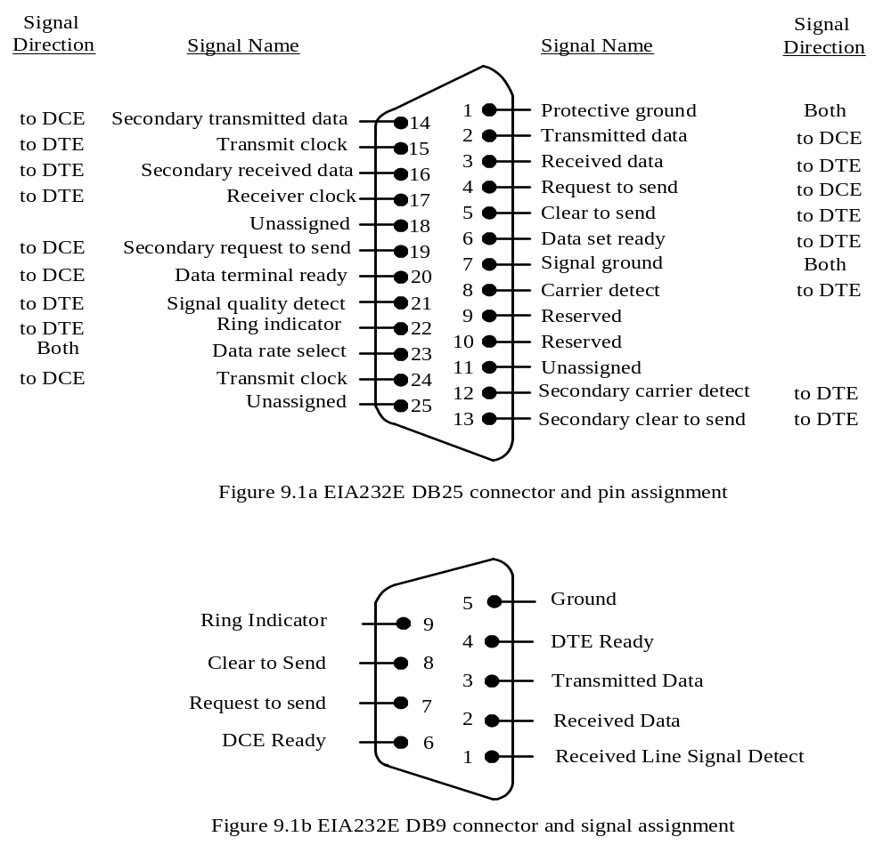

Slide 9
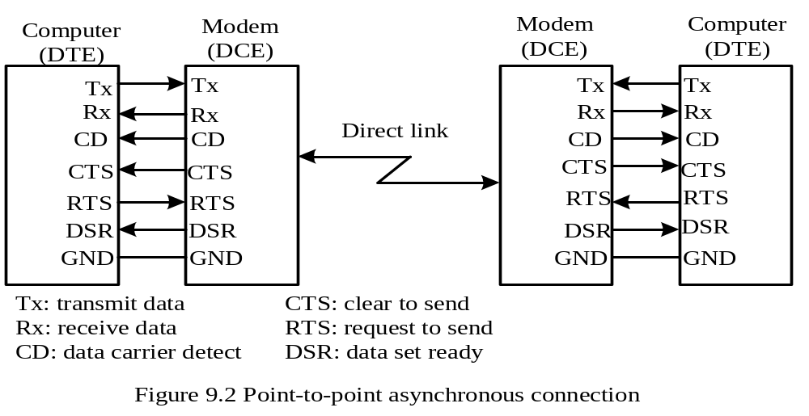
EIA232 Procedural Specification
Case 1: Point-to-point asynchronous connection

Slide 10
Sequence of events occurred during data transmission over dedicated link
Local
Time
Remote
1. DCE asserts DSR
2. DTE asserts RTS
3. DCE asserts CTS
4. DTE starts to send
data (to local DCE)
5. DCE sends out a
carrier and then the
modulated data
6. DCE asserts DCD
7. DTE waits for
arrival of data
8. DCE sends out
demodulated
received data
9. DEC receives
demodulated data

Slide 11
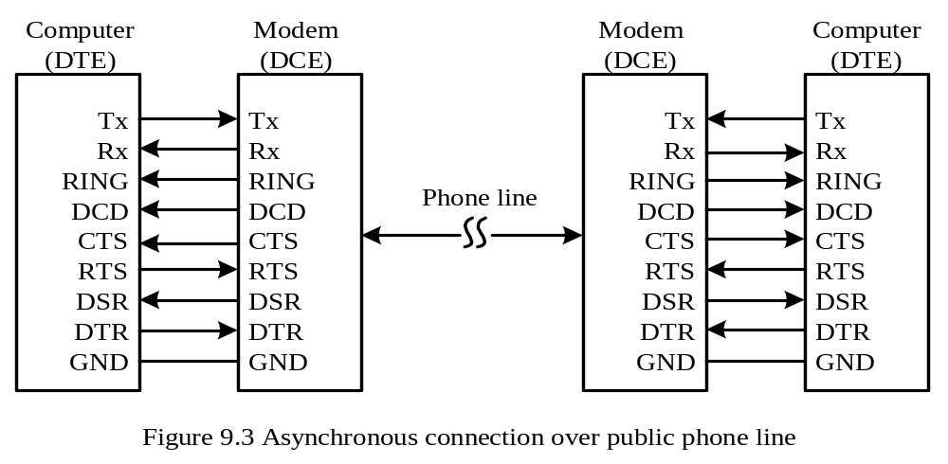
Case 2: two DTEs exchange data over public phone lines
- Two additional signals are needed: DTR and RI
There are three phases in the data transmission:
1. Establishing the connection
2. Data transmission
3. Disconnection

Slide 12
Local
(transmission side)
time
Remote (receiving side)
Connection
establishment
phase
1. DTE asserts DTR
2. DCE dials the
phone number
3. DCE detects the ring
and asserts RING
4. DTE asserts DTR
to accept the call
5. DCE sends out a
carrier and asserts
DSR
6. DCE asserts DSR
and DCD and also
sends out a carrier
for full duplex
operation
7. DCE asserts DCD
(full duplex operation)

Slide 13
Sequence of events occur during data transmission (continued)
Local
(transmission side)
time
Remote (receiving side)
Data
transmission
phase
1. DTE asserts RTS
2. DCE asserts CTS
3. DTE sends out
data to DCE
4. DCE modulates data
and sends it out
5. DCE demodulates
data and forwards
the data to DTE
6. DTE receives
data
Disconnection
phase
1. DTE drops RTS
2. DCE drops CTS
and drops the carrier
3. DCE deasserts
DCD & DSR
4. DTE deasserts
DTR

Slide 14
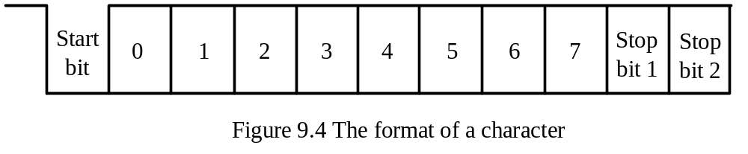
Data Format
Data is transmitted character by character
Each character is preceded by a start bit, followed by seven to nine data bits, and terminated by one to two stop bits.
The receiver uses a clock signal with a frequency that is a multiple (usually 16) of the data rate to sample the incoming data in order to detect the arrival of start bit and determine the bit values.
A majority circuit takes three samples (bit 7, 8, and 9) in each bit time to detect the arrival of the start bit and determine the logic value of each data bit.
In older designs, a character can be terminated by one, one and a half, two stop bits.
In new designs, only one stop bit is used.

Slide 15
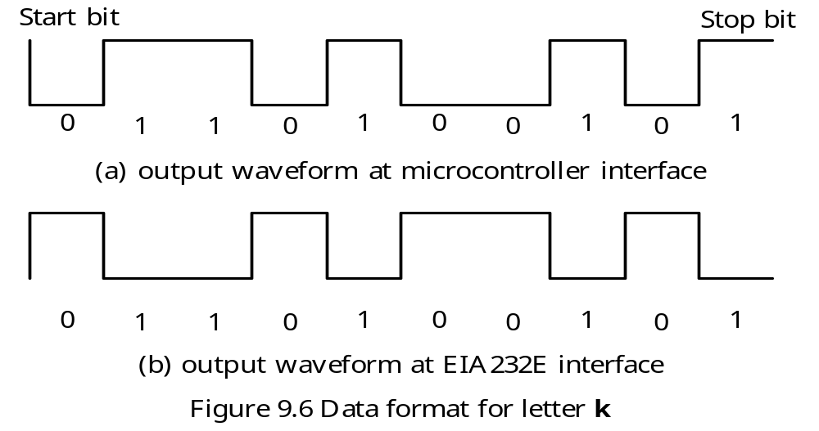
Example 9.1 Sketch the output of the letter K when it is transmitted using the format of one start bit, eight data bits, and one stop bit.
Solution: Letters are represented in ASCII code. The ASCII code of letter K is $4B (= 01001011). The format of the output of letter K is shown in Figure 9.6.

Slide 16
Data Transmission Errors
1. Framing error
- May occur due to clock synchronization problem
- Can be detected by the missing stop bit
2. Receiver overrun
- May occur when the CPU did not read the received data for a while
3. Parity errors
- Occur due to odd number of bits change values

Slide 17
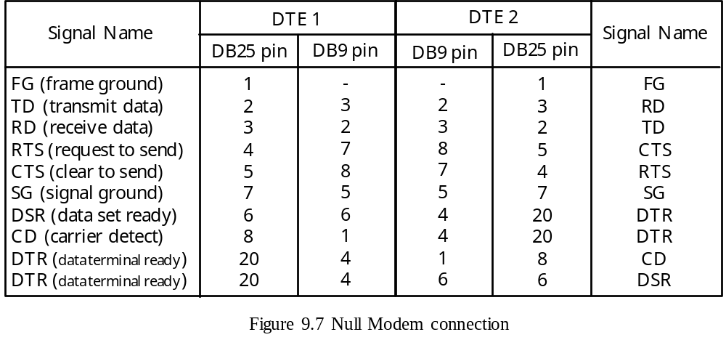
Null Modem Connection
Used when two DTEs are located side by side and use the EIA232 interface to exchange data.
Null modem connection connects signals in such a way to full two DTEs to think that they connected through a modem.
In Figure 9.7, the signals on the same row of DTE1 and DTE2 are connected together.
The cost of two modems are saved with Null modem connection.

Slide 18
The PIC18 Serial Communication Interface
A serial communication interface can be called a USART or UART.
A USART supports both synchronous and asynchronous modes of operation.
A PIC18 device supports either one or two identical USARTs.
The USART port can be used to communicate with a CRT terminal, a personal computer, A/D converter, D/A converter, and serial EEPROMs.
The USART can operate in three modes:
1. Asynchronous mode (full duplex)
2. Synchronous—master (half duplex)
3. Synchronous—slave (half duplex)
USART-Related Pins
RC6/TX1/CK1 and RC7/RX1/DT1 (USART1)
RG1/TX2/CK2 and RG2/TX2/DT2 (USART2)
USART-Related Registers
Transmit status register (TXSTA) - Transmit register (TXREG)
Receive status register (RCSTA) - Receive register (RCREG)
Baud rate generate register (SPBRG)

Slide 19
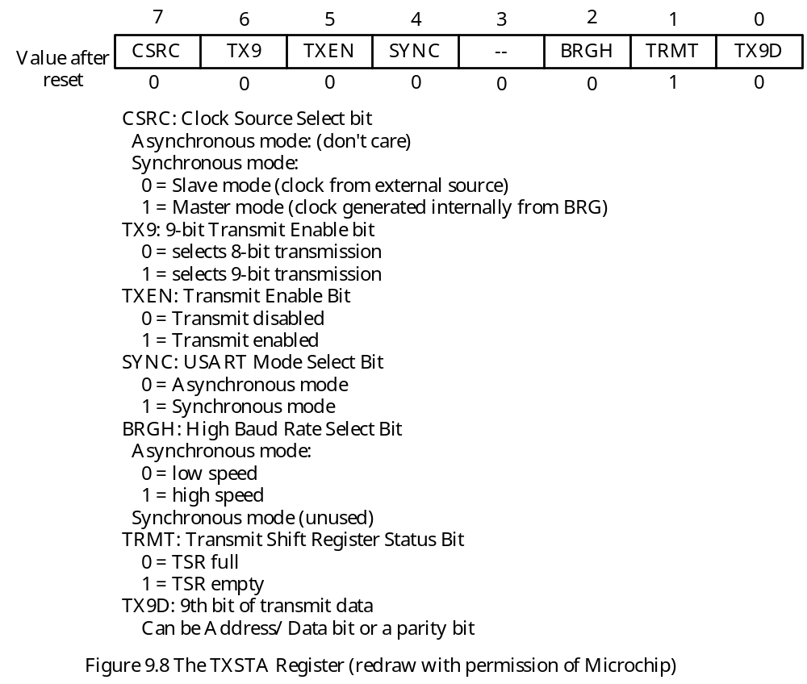

Slide 20
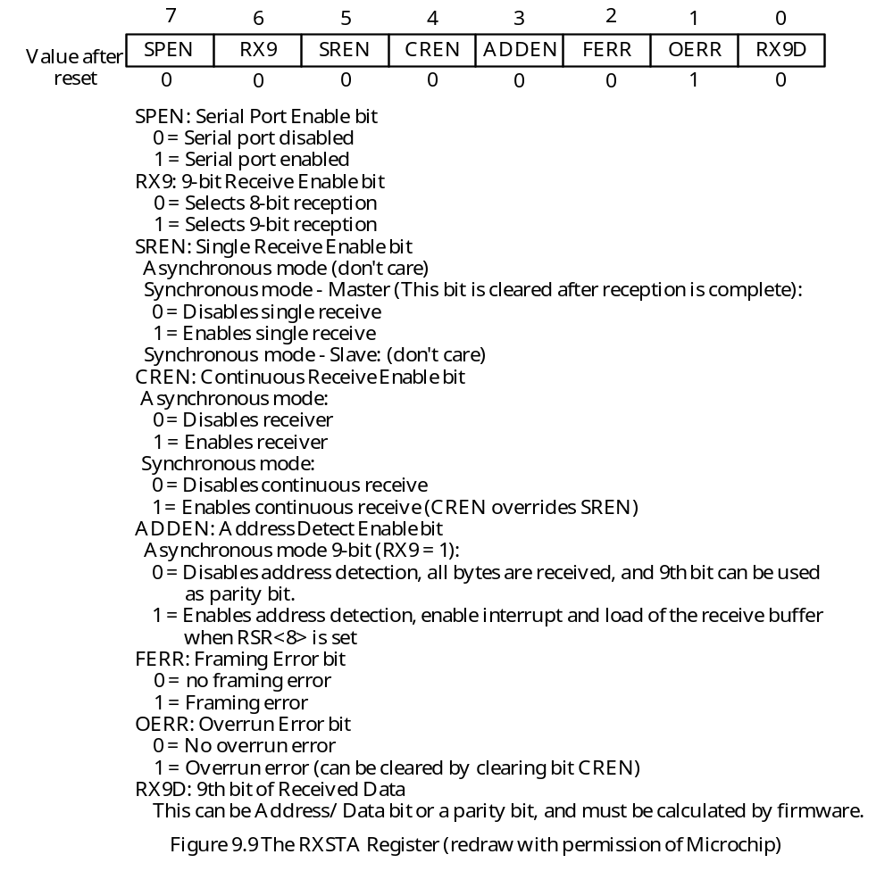

Slide 21
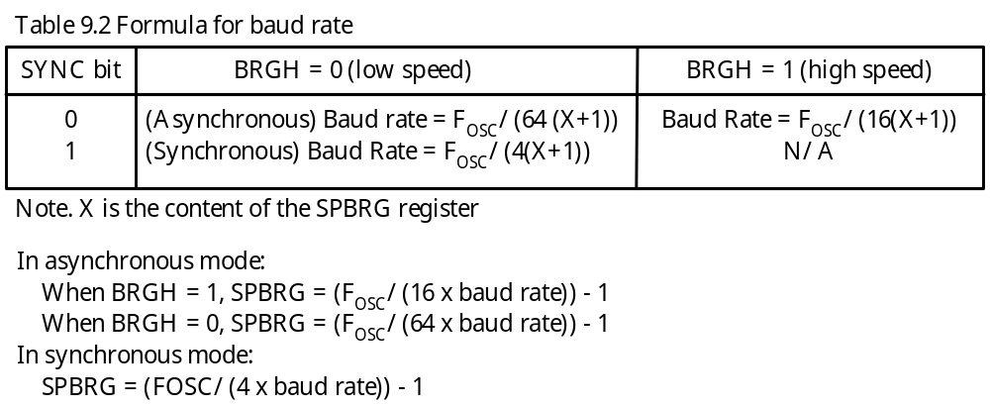
The shift clock for the USART is generated by the baud rate generator (SPBRG).
In asynchronous mode, the BRGH bit of the TXSTA register also involves in the baud rate computation.
The baud rate is computed using the formula shown in Table 9.2.

Slide 22
Example 9.2 Compute the value to be written into the SPBRG register to generate 9600 baud for asynchronous mode high-speed transmission assuming the frequency of the crystal oscillator is 20 MHz.
Solution: The value (for BRGH = 1) to be written into the SPBRG register is
SPBRG = 20 × 10⁶ ÷ (16 × 9600) – 1 = 130 – 1 = 129
The actual baud rate is
20,000,000 ÷ (16 × 130) = 9615.4
The resultant error rate is (9615.4 – 9600) ÷ 9600 × 100% = 0.16%.
The same baud rate can also be achieved by using low speed (BRGH = 0) approach in which
SPBRG = 20,000,000 ÷ (64 × 9600) – 1 = 31
The actual baud rate is
20000000 ÷ (64 × 32) = 9765.6
The resultant error rate is (9765.6 – 9600) ÷ 9600 × 100% = 1.7%.

Slide 23
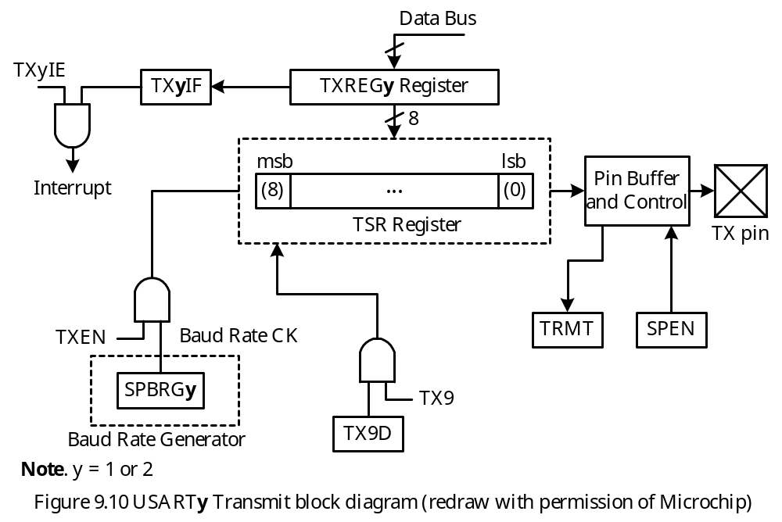
USART Asynchronous Mode
Data format is one start bit, eight or nine data bits, and one stop bit.
The least significant bit is transmitted first
The transmitter and receiver are independent but use the same data format and baud rate.
Asynchronous mode is stopped in sleep mode.
The diagram of the transmitter block is shown in Figure 9.10.

Slide 24
Example 9.3 Write a subroutine to configure the USART1 transmitter to transmit data in asynchronous mode using 8-bit data format, disable interrupt, set baud rate to 9600. Assume the frequency of the crystal oscillator is 16 MHz.
Solution:
Write the value of 0x24 into the TXSTA1 register
Configure TX1 pin for output, RX1 pin for input:
usart1_open movlw 0x24
movwf TXSTA1
movlw D’103’ ; set baud rate to 9600
movwf SPBRG1 ; “
bsf TRISC,RC7 ; configure RX1 pin for input
bcf TRISC,RC6 ; configure TX1 pin for output
bcf PIE1,TXIE ; disable transmit interrupt
bsf RCSTA1,SPEN ; enable USART1
return

Slide 25
In C language,
void usart1_open(void)
{
TXSTA1 = 0x24;
SPBRG1 = 103;
TRISCbits.RC7 = 1; /* configure RX1 pin for input */
TRISCbits.RC6 = 0; /* configure TX1 pin for output */
PIE1bits.TXIE = 0; /* disable transmit interrupt */
RCSTA1bits.SPEN = 1; /* enable USART port */
}

Slide 26
Example 9.4 Write a subroutine to output the character in WREG to USART1 using the polling method.
Solution:
Data can be sent to the transmitter only when the transmit register is empty.
putc_usart1 btfss PIR1,TXIF,A ; wait until TXIF flag is set before output
bra putc_usart1
movwf TXREG1
return
In C language,
void putc_usart1 (char xc);
{
while (!PIR1bits.TX1IF);
TXREG1 = xc;
}

Slide 27
Example 9.5 Write a subroutine to output a string (in program memory) pointed to by TBLPTR and terminated by a NULL character from USART1.
Solution:
; *******************************************************************
; The following subroutine outputs the string pointed to by TBLPTR. It is called
; with fast save enabled.
; *******************************************************************
puts_usart1 TBLRD*+ ; read one character into TABLAT
movf TABLAT,W,A ; place the character in WREG
bz done ; is it a NULL character?
call putc_usart1 ; not NULL, output
bra puts_usart1 ; continue
done return fast
In C language,
void puts_usart1 (unsigned rom char *cptr)
{
while(*cptr)
putc_usart1 (*cptr++);
}

Slide 28
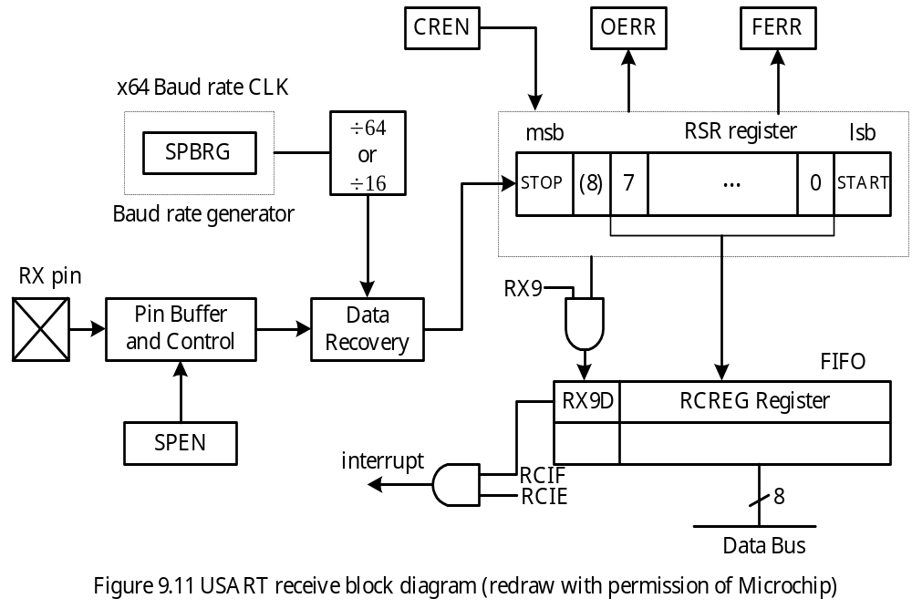

Slide 29
Example 9.6 Write an instruction sequence to configure the USART1 to receive data in asynchronous mode using 8-bit data format, disable interrupt, set baud rate to 9600. Assume that the frequency of the crystal oscillator is 16 MHz.
Solution:
movlw 0x90 ; enable USART1 and receiver
movwf RCSTA1,A
movlw D’103’
movwf SPBRG1,A ; set up baud rate to 9600
bsf TRISC,RX1,A ; configure RX1 pin for input
bcf TRISC,TX1,A ; configure TX1 pin for input
In C language,
RCSTA1 = 0x90;
SPBRG = 103;
TRISC |= 0x80; /* configure RC7/RX1 pin for input */
TRISC &= 0xBF /* configure RC6/TX1 pin for output */

Slide 30
Example 9.7 Write a subroutine to read a character from USART1 and return the character in WREG using the polling method. Ignore any errors.
Solution: A new character is received if the RCIF flag of the PIR1 register is set to 1.
getc_usart1 btfss PIR1,RCIF ; make sure a new character has been received
bra getc_usart1
movf RCREG1,W ; read the character
return FAST
In C language,
unsigned char getc_usart1 (void)
{
while (!PIR1bits.RCIF);
return RCREG1;
}

Slide 31
Example 9.8 Write a subroutine to read a string from the USART1 and store the string in a buffer pointed to by FSR0.
Solution:
The string from the USART port is terminated by a carriage return character.
CR equ 0x0D
gets_usart1 call getc_usart1
movwf INDF0 ; save the character in buffer
sublw CR
bz done
clrf PREINC0,F ; move the pointer
goto gets_usart1
done clrf INDF0 ; terminate the string with a NULL character
return

Slide 32
In C language,
#define CR 0x0D
void gets_usart1 (char *ptr)
{
char xx;
while (1)
{
xx = getc_usart1( ); /* read a character */
if (xx == CR) { /* is it a carriage return? */
*ptr = ‘\0’; /* terminate the string with a NULL */
return;
}
ptr++ = xx; /* store the received character in the buffer */
}
}

Slide 33
Flow Control of USART in Asynchronous Mode
In some circumstances, the software cannot read the received data and needs to inform the transmitter to stop.
In some other situation, the transmitter may need to be told to suspend transmission because the receiver is too busy to read data.
Both situations are handled by flow control.
There are two flow control methods: hardware and XON/XOFF.
XON and XOFF are two standard ASCII characters.
The ASCII code for XON and XOFF are 0x11 and 0x13, respectively.
Whenever a microcontroller cannot handle the incoming data, it sends the XOFF to the transmitter.
When the microcontroller can handle incoming characters, it sends out XON character.

Slide 34
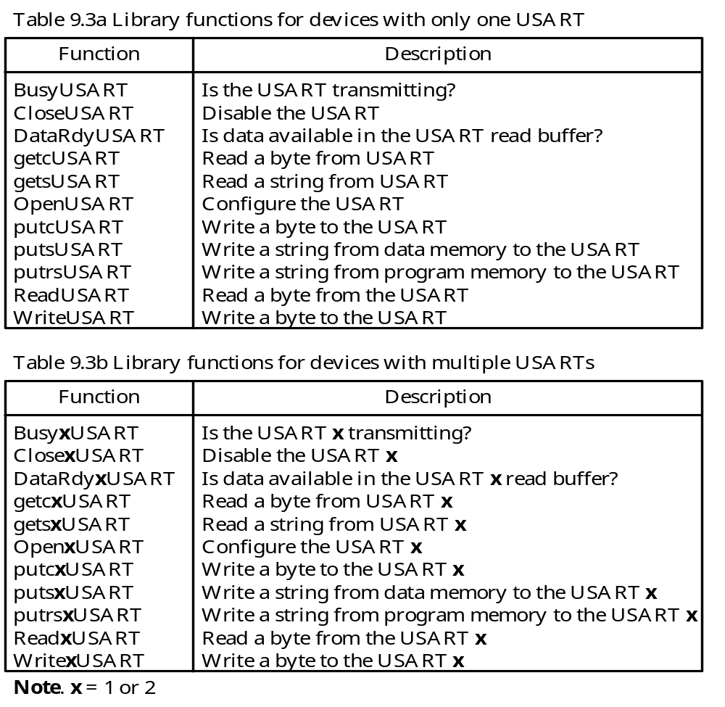
C Library Functions for USART

Slide 35
The following functions return a “1” if the transmitted is busy:
char BusyUSART (void); -- used on devices with single USART
char Busy1USART (void); -- used on devices with two USARTs
char Busy2USART (void); -- used on devices with two USARTs
The following functions disable the transmitter and receiver:
void CloseUSART (void); -- used on devices with single USART
void Close1USART (void); -- used on devices with two USARTs
void Close2USART (void); -- used on devices with two USARTs
The following functions return a “1” if the RCIF flag is set:
char DataRdyUSART (void); -- used on devices with single USART
char DataRdy1USART (void); -- used on devices with two USARTs
char DataRdy2USART (void); -- used on devices with two USARTs

Slide 36
Any one of the following functions read a byte from the receive buffer including the 9th bit:
char getcUSART (void); -- used on devices with single USART
char getc1USART (void); -- used on devices with two USARTs
char getc2USART (void); -- used on devices with two USARTs
char ReadUSART (void); -- used on devices with single USART
char Read1USART (void); -- used on devices with two USARTs
char Read2USART (void); -- used on devices with two USARTs
The following functions read the specified number of byes from the USART module and save the string in a buffer:
void getsUSART (char *buffer, unsigned len); -- for devices with single USART
char gets1USART (char *buffer, unsigned len); -- for devices with two USART
char gets2USART (char *buffer, unsigned len); -- for devices with two USART

Slide 37
The status bit and the 9th data bit are saved in a union with the following declaration:
union USART
{
unsigned char val;
struct
{
unsigned RX_NINE: 1;
unsigned TX_NINE: 1;
unsigned FRAME_ERROR: 1;
unsigned OVERRUN_ERROR: 1;
unsigned fill: 4;
};
};

Slide 38
The following functions write one character to the transmit buffer:
char putcUSART (char data); -- used on devices with single USART
char putc1USART (char data); -- used on devices with two USARTs
char putc2USART (char data); -- used on devices with two USARTs
char WriteUSART (char data); -- used on devices with single USART
char Write1USART (char data); -- used on devices with two USARTs
char Write2USART (char data); -- used on devices with two USARTs
The following functions output a string in program memory to the USART module:
void putrsUSART (const rom char *data); -- used on devices with single USART
void putrs1USART (const rom char *data); -- used on devices with two USARTs
void putrs2USART (const rom char *data); -- used on devices with two USARTs
The following functions output a string in data memory to the USART module:
void putsUSART (char *data); -- used on devices with single USART
void puts1USART (char *data); -- used on devices with two USARTs
void puts2USART (char *data); -- used on devices with two USARTs

Slide 39
The following functions configured the specified USART module:
void OpenUSART (unsigned char config,
char spbrg); -- used on devices with single USART
void Open1USART (unsigned char config,
char spbrg); -- used on devices with two USARTs
void Open2USART (unsigned char config,
char spbrg); -- used on devices with two USARTs
The config parameter is defined by ANDing the following parameters:
Interrupt on Transmission:
USART_TX_INT_ON Transmit interrupt ON
USART_TX_INT_OFF Transmit interrupt OFF
Interrupt on Reception:
USART_RX_INT_ON Receive interrupt ON
USART_RX_INT_OFF Receive interrupt OFF
USART Mode:
USART_ASYNCH_MODE Asynchronous mode
USART_SYNCH_MODE Synchronous mode

Slide 40
Transmission Width:
USART_EIGHT_BIT 8-bit transmit/receive
USART_NINE_BIT 9-bit transmit/receive
Slave/Master Select:
USART_SYNC_SLAVE Synchronous slave mode
USART_SYNC_MASTER Synchronous master mode
Reception mode:
USART_SINGLE_RX Single reception
USART_CONT_RX Continuous reception
Baud rate: (applied to asynchronous mode only)
USART_BRGH_HIGH High baud rate
USART_BRGH_LOW Low baud rate
The spbrg is the value to be written into the SPBRG register to set the baud rate.
An example,
Open1USART (USART_TX_INT_OFF & USART_RX_INT_OFF &
USART_ASYNCH_MODE & USART_EIGHT_BIT &
USART_BRGH_HIGH, 103);

Slide 41
Interface Asynchronous Mode USART with EIA232
- The USART in asynchronous mode is mainly used with the EIA232 interface.
The USART module uses 0 and 5V to represent logic 0 and 1 and hence cannot be connected to the EIA232 circuit directly.
A circuit called EIA232 transceiver is needed to translate the voltage levels of the USART to and from the voltage levels of the EIA232 interface.
EIA232 transceivers are available from many vendors.
LT1080/1081 from Linear Technology, ST232 from SGS Thompson, the ICL232 from Intersil, the MAX232 from MAXIM, and the DS14C232 from National Semiconductor are examples of the EIA232 transceiver. These EIA232 transceivers operate with a 5-V power supply.
The pin assignment of the MAX232 is shown in Figure 9.12.
The circuit connection of the MAX232 with the PIC18 is shown in Figure 9.13.

Slide 42
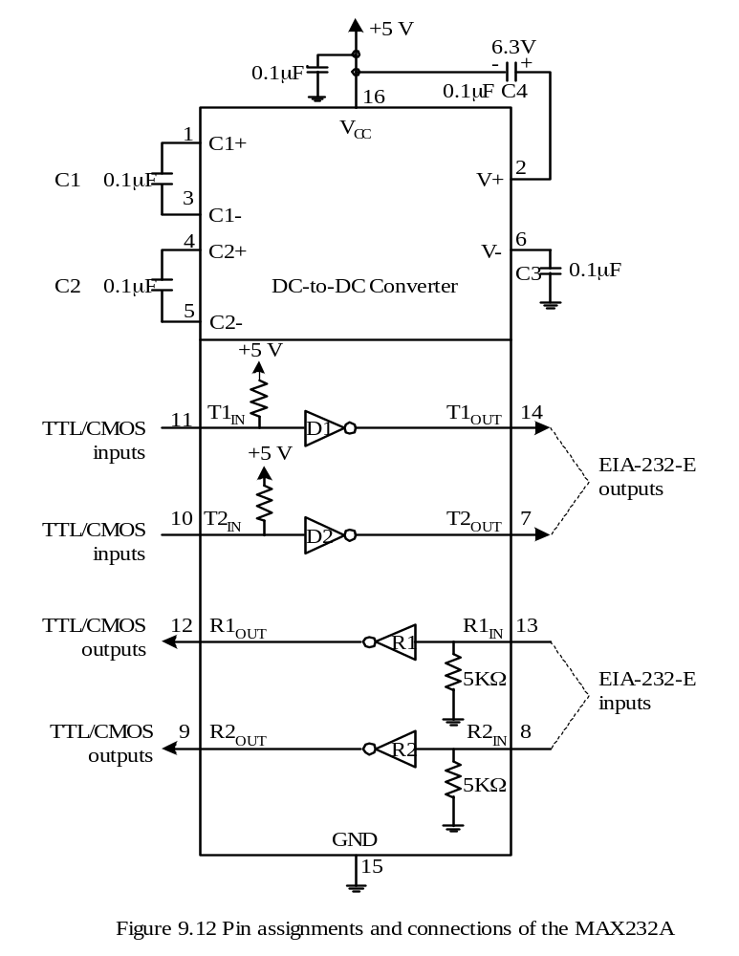

Slide 43
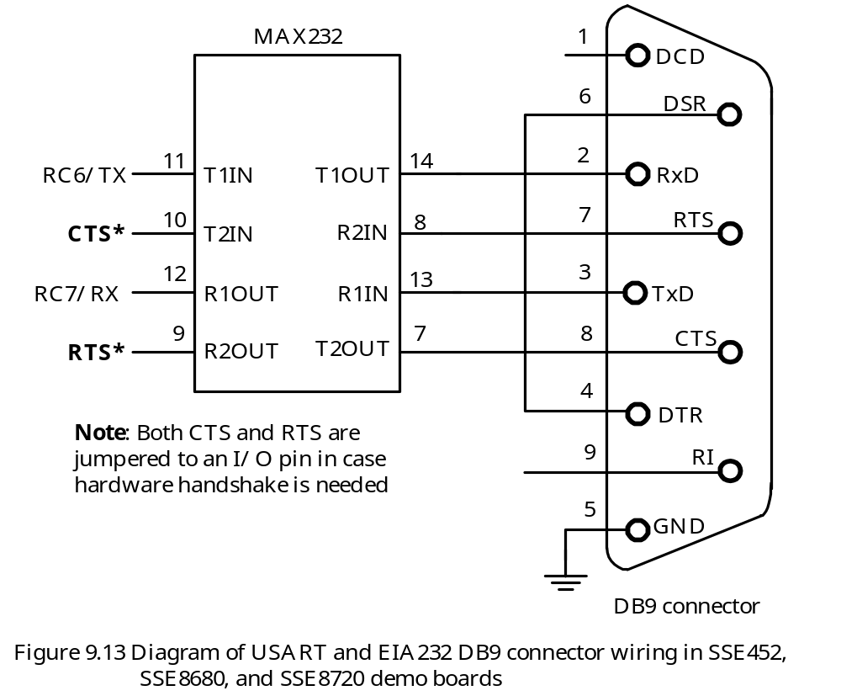

Slide 44
USART Synchronous Master Mode
This mode is entered by setting bits SYNC, SPEN and CSRC.
Data is transmitted in half-duplex mode.
The clock signal is driven out from the CK pin.
Synchronous Master Transmission
- Setting the TXEN bit enables the USART module, which will start the SPBRG circuit to generate the shift clock.
The actual data transmission does not start until a byte is written into the TXREG register.
The data bits are shifted out on the rising edge of CK and becomes stable on the falling edge of the same clock period.
Synchronous Master Reception
Reception is enabled by setting the SREN or CREN bit.
Data is sampled on the falling edge of the CK clock.
If only the SREN bit is set, only one character will be received.
If the CREN bit is set, the reception will continue until the CREN bit is cleared.

Slide 45
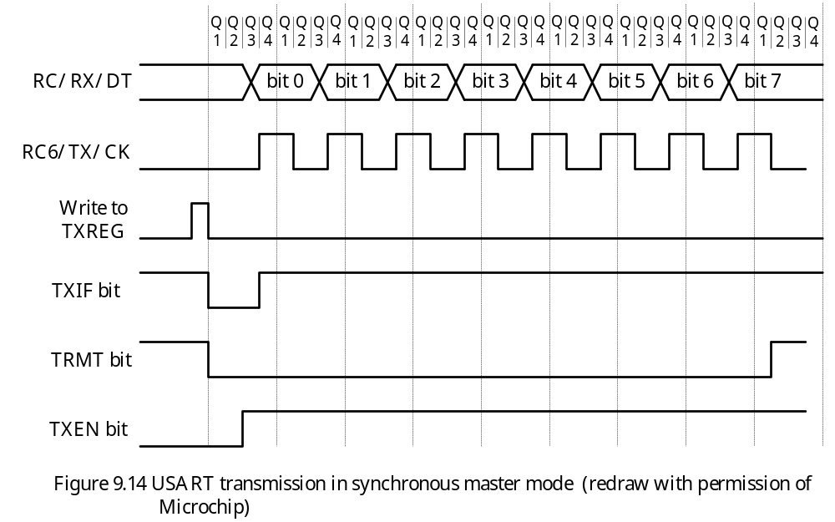

Slide 46
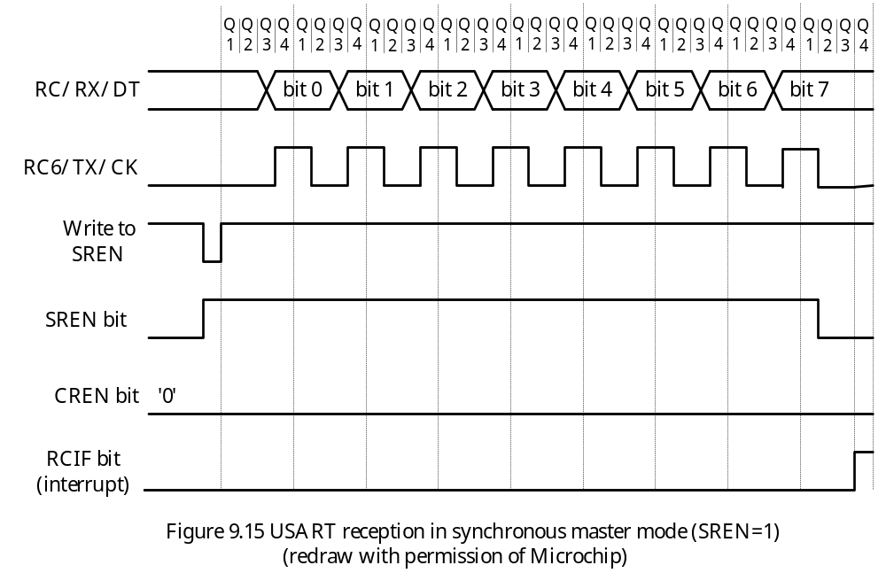

Slide 47
USART Synchronous Slave Mode
Shift clock is provided by external device and is input to the CK pin.
Slave mode is entered by setting both the SYNC and SPEN bits and clearing the CSRC bit.
Synchronous Slave Transmission
The shift clock signal is an input from the CK pin.
CREN bit must be cleared.
Transmission is enabled by setting the TXEN bit.
Transmission is started by loading data into the TXREG register.
Synchronous Slave Reception
Clock source is an input from the CK pin.
When the RCIF flag is set, read the RCREG register to get the lower 8 bits.
If 9-bit reception is enabled, then read the 9th bit from the RCSTA register.
If there is any error, then clear the error by clearing the CREN bit.

Slide 48
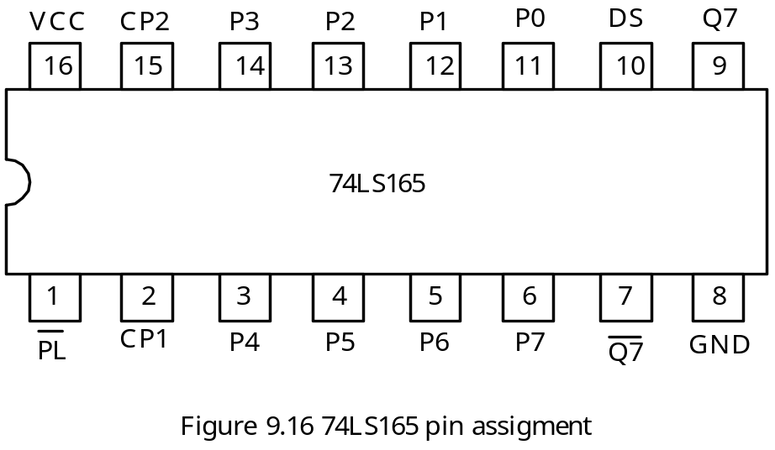
Applications of USART Synchronous Mode
Interfacing with shift registers to expand the number of I/O ports.
Exchange data with other PIC18 microcontrollers
The 74LS165 Shift Register
Has parallel inputs P7…P0 to be loaded into 74LS165 when PL is low.
Data is shifted in from the DS pin when the PL input is high, one clock input is high, and the second clock input has a rising edge.
Data is shifted out from Q7, which allows multiple 74LS165 to be concatenated.

Slide 49
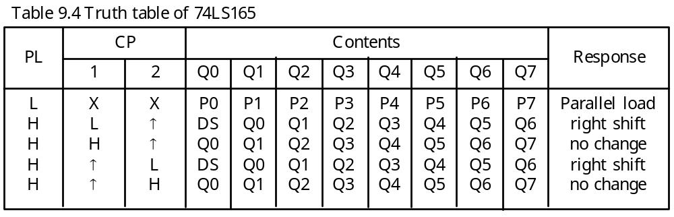
Example 9.9 Show the circuit connection for using one 74LS165 to add an input port to the PIC18F8720 using the USART2 in synchronous master mode. Write a subroutine to configure the USART2 properly and a subroutine to shift one byte of data assuming that the PIC18F8720 is running with a 16-MHz crystal oscillator. Assume that the user uses eight switches to set the value to be input and uses INT1 interrupt to inform the arrival of data.
Solution:
1. Use the synchronous master mode to interface with the 74LS165.
2. Configure RG2/DT2 and RG1/CK2 for input and output, respectively.
3. Set baud rate to 1 Mbps
4. Enable INT1 interrupt
5. Circuit connection is shown in Figure 9.17.

Slide 50
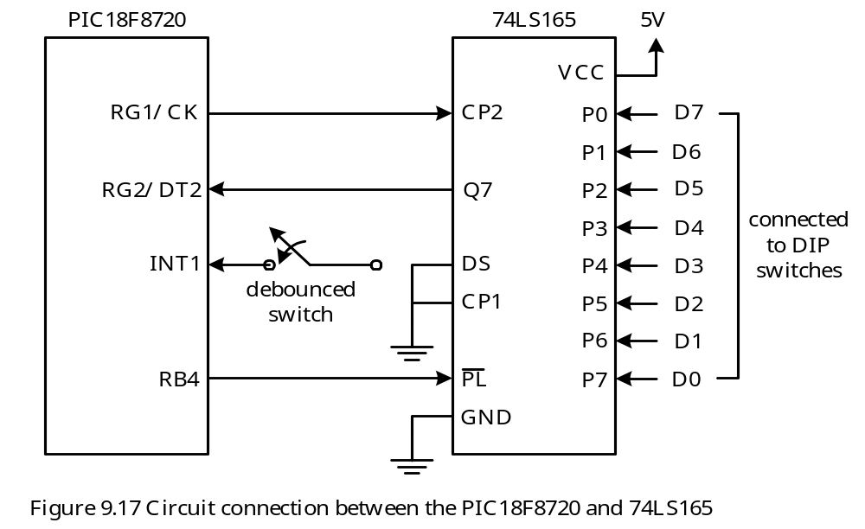

Slide 51
Procedure for inputting data from 74LS165
1. Set up a new value to P0 to P7 using the DIP switches.
2. Press the debounced switch to request an interrupt using the INT1 pin.
3. The INT1 interrupt service routine reads in the data from the RCREG2.
#include <p18F8720.inc>
rcv_buf set 0 ; buffer to hold the received byte
org 0x00
goto start
org 0x08
goto hi_ISR
org 0x18
retfie
start bcf TRISG,RG1,A ; configure CK2 pin for output
bsf TRISG,RG2,A ; configure DT2 pin for input
call open_usart2
call open_INT1
forever nop
bra forever

Slide 52
; *****************************************************************
; The following function configures USART2 to operate in
; synchronous master mode with baud rate set to 10**6.
; *****************************************************************
open_usart2 movlw 0x03
movwf SPBRG2,A ; set the shift rate to 1MHz
movlw 0x90 ; set synchronous master mode
movwf TXSTA2,A ; "
movlw 0x80 ; enable USART2 and disable
movwf RCSTA2,A ; reception
return
; ************************************************************************
; The following subroutine configures INT1 to high priority and
; then enable its interrupt.
; ************************************************************************
open_INT1 bsf RCON,IPEN,A ; enable priority interrupt
movlw 0x48 ; set INT1 interrupt to high priority,
movwf INTCON3,A ; and then enable INT1 interrupt
movlw 0xC0 ; enable global interrupt
movwf INTCON ; "
return

Slide 53
; *************************************************************************
; The high priority interrupt service routine makes sure
; that the interrupt is caused by usart2 INT1IF and then enable
; reception by setting SPEN bit. Wait until a byte is received.
; *************************************************************************
hi_ISR btfss INTCON3,INT1IF,A ; is interrupt caused by INT1?
retfie ; interrupt is not caused by INT1
bcf INTCON3,INT1IF,A ; clear INT1IF
bcf PORTB,RB4,A ; load data into 74LS165
nop ; "
bsf PORTB,RB4,A ; disable new data into 74LS165
bcf PIR3,RC2IF,A ;
bsf RCSTA2,SREN,A ; enable single reception from USART2
wait btfss PIR3,RC2IF,A ; wait for the arrival of a byte
bra wait
movff RCREG2,rcv_buf
retfie
end

Slide 54
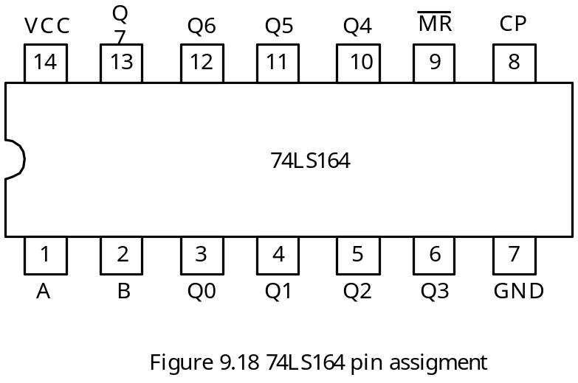
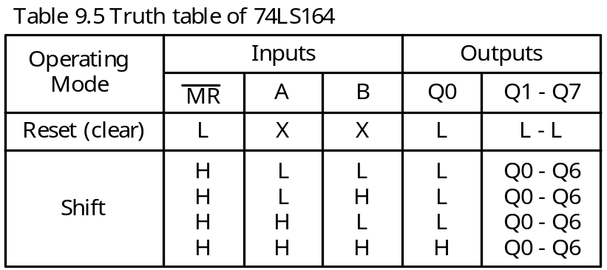
The 74LS164 Shift Register
Has parallel outputs and two serial inputs
Pin assignment and truth table are shown in Figure 9.18 and Table 9.5, respectively.

Slide 55
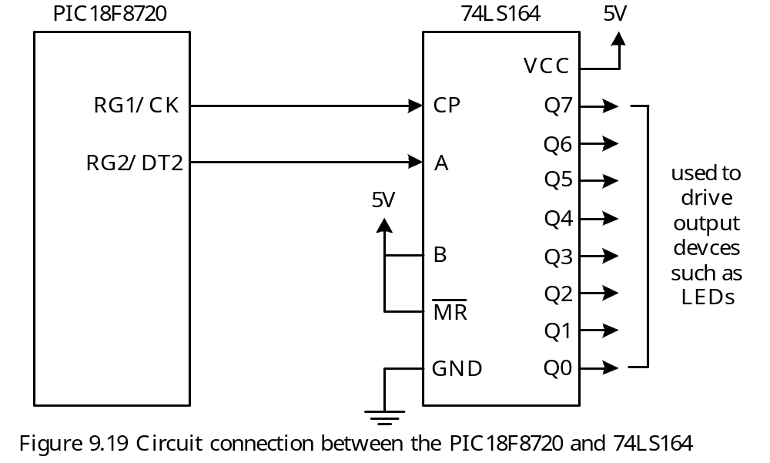
Example 9.10 Show the circuit connection if you are to use one 74LS164 to add an output port to the PIC18F8720 using the USART2 module in synchronous master mode. Write a subroutine to shift out one byte of data assuming that the PIC18F8720 is running with a 16-MHz crystal oscillator. The user may uses Q7..Q0 to drive LEDs.
Solution: The circuit connection is shown in Figure 9.19. Q7…Q0 should be used as the least significant bit to the most significant bit.

Slide 56
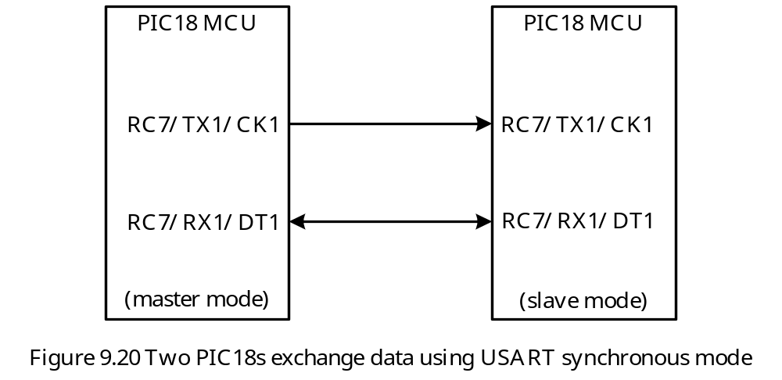
The following subroutine outputs the character in WREG to the USART2:
outc_usart2 bsf RCSTA2,SPEN ; enable USART2 port pins
poll2 btfss PIR3,TX2IF,A ; is TX2IF flag set?
bra poll2
movwf TXREG2,A
return
Using the USART Synchronous Mode to Exchange Data with other PIC18 MCUs

Slide 57
Enhanced USART
Newer PIC18 devices add some enhancements to the USART port:
1. Automatic baud rate detection and calibration
2. Sync break reception
3. 12-bit break character transmit
4. A baud rate control register (BAUDCONx, x = 1, or 2) is added for additional baud control
- These additional features can be used to support the LIN protocol

